Slide 1


OESON PROJECT 3
Anass El Aqli

Slide 2

Content
Introduction
Visualizations
Preparing data for ML
Logistic Regression
More Visualizations
Decision Tree
Support Vector Machine
Random Forest
Gaussian Naive Bayes
Conclusion

Slide 3

Introduction
In this project, we were given data from a university, which from the data we can safely assume that it's a Portuguese university. The dataset has 4424 rows × 35 columns, which includes relevant information about the students. We have to do visualizations on the data and prepare prediction models that predict whether a student will graduate or drop out using at least five machine learning algorithms.
In this project, I used Python and its libraries: pandas, Matplotlib, Seaborn, Numpy, and of course scikit-learn.

Slide 4
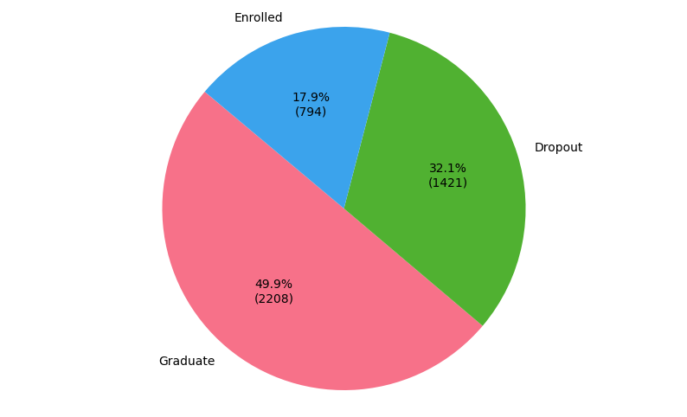

Visualizations
Before going into machine learning
We can see that our Target column consists of 3 types of values (Enrolled, Dropout, and Graduate).
Our focus for this project is whether the student will graduate or drop out. Thus, we will exclude the records with Target=’Enrolled’.

Slide 5

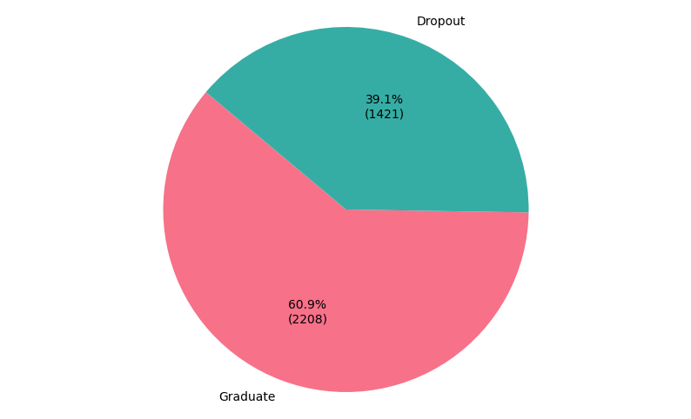
Preparing data for ML
Now, we excluded the records where Target=’Enrolled’.
But still, the Target column has text values. We need to make them numerical so the ML algorithms can deal with them.

Slide 6
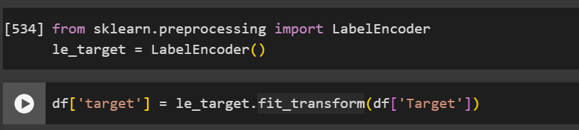
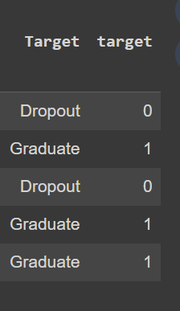
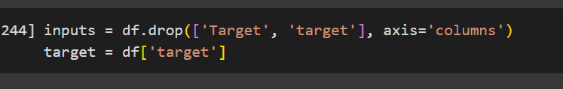
Preparing data for ML
Using LabelEncoder from the Sklearn library we translated ‘Target’ text data to numerical data in a column we named ‘target’.
Then for the input data that we’ll use to train our models we’ll use all the columns except ‘Target’ and ‘target’ columns.
We’ll only keep the numerical target column for our target data.

Slide 7
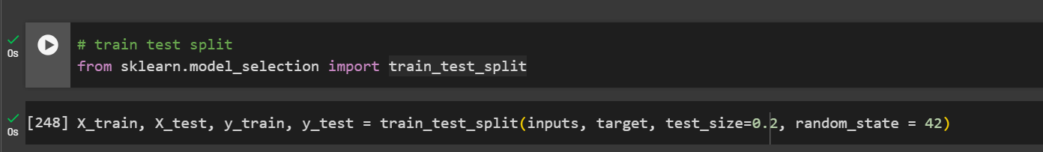
Train Test Split
Now, we will split the data into training and testing data.
I split it into 80% training data and 20% testing data.

Slide 8
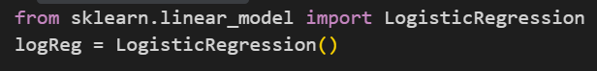
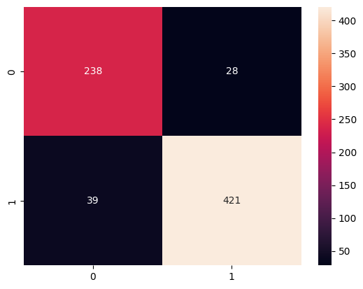
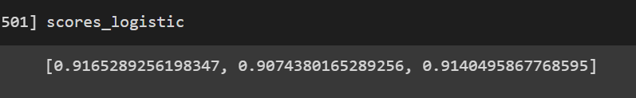
Logistic Regression
So using regression, and from the confusion matrix, we can see that our model was right 238 times about the student dropping out but wrong 28 times. The model was right 421 times and wrong 39 times when it predicted that someone would graduate.
Using K Fold Cross Validation we can see that the score of our model performance is somewhere around those values:

Slide 9
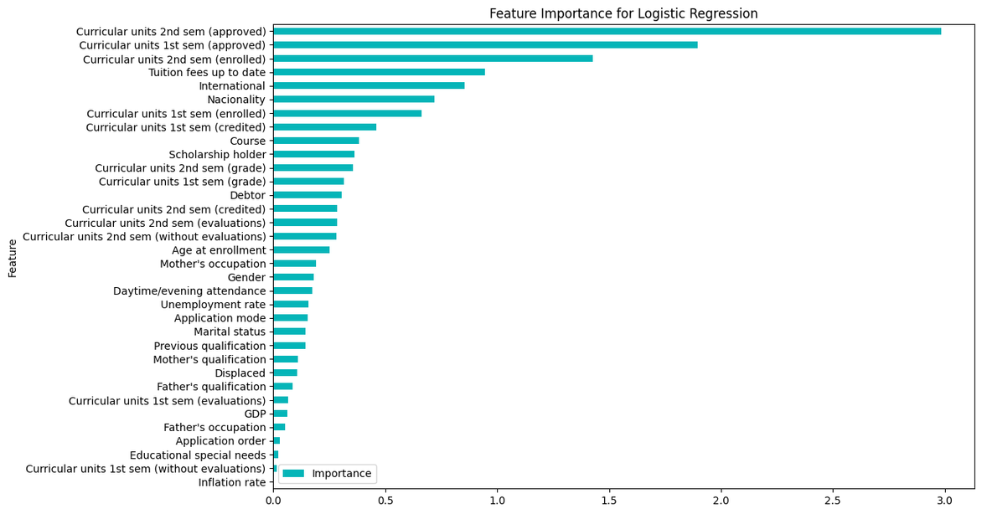
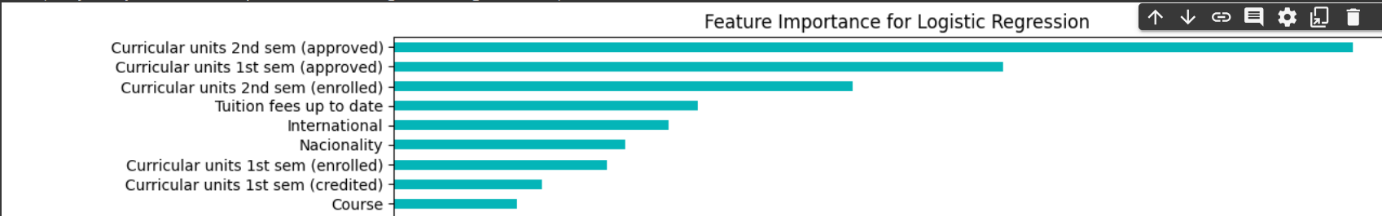
Logistic Regression
These are the columns by their importance for the Logistic Regression.
As it’s demonstrated, Curricular units 2nd sem (approved) played the biggest role.
Let’s visualize some of these features in relation to graduating or dropping out.

Slide 10
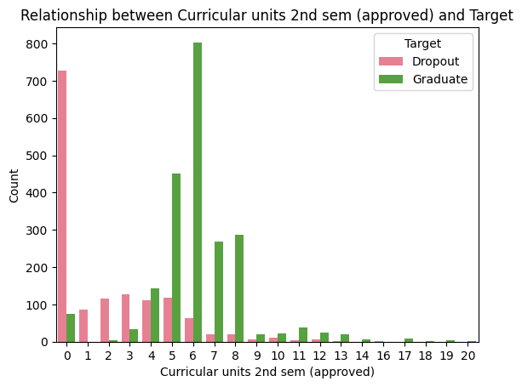
Visualizations
We can see Curricular units 2nd sem (approved) indeed have lots of influence on dropping out or graduating.
For example, the majority of those with curricular unit number 0 dropped out, while most of those with curricular unit 6 graduated.

Slide 11
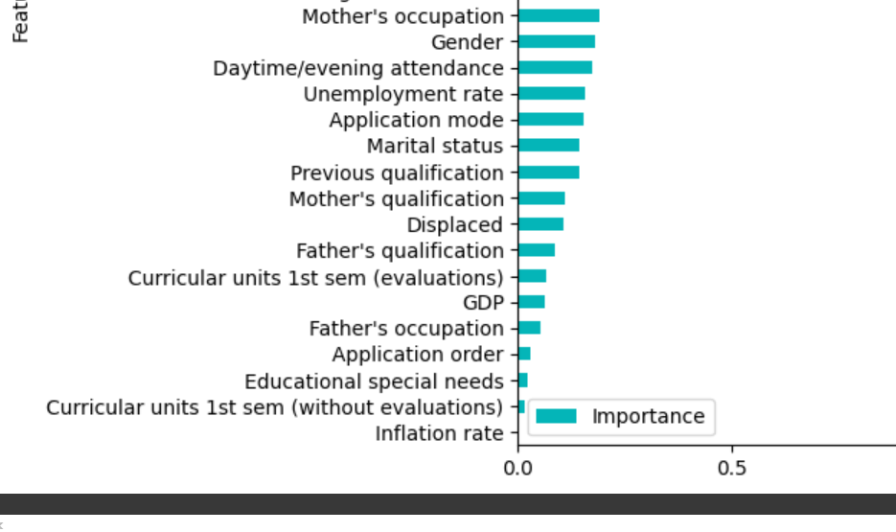
Visualizations
These were the least important features for our regression.
It is nice to know that factors like educational special needs did not play a huge role in deciding whether someone graduate or not.

Slide 12
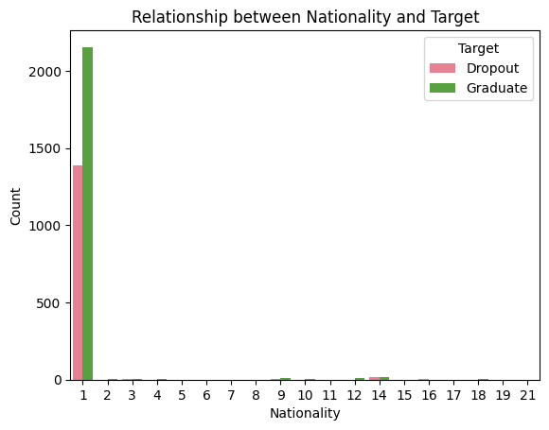
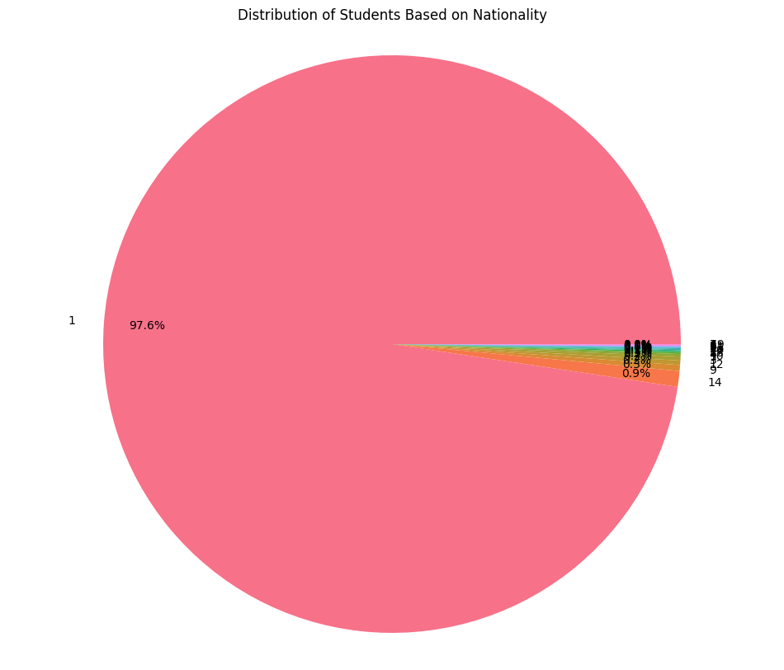
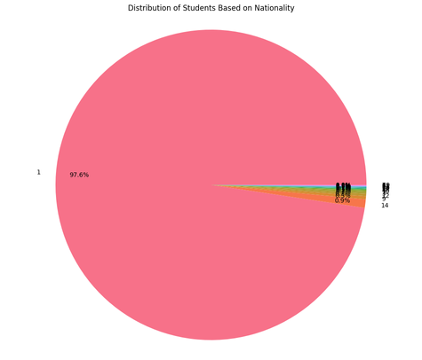
Visualizations
For features like nationality we can barely see how influential it is just by plotting it because 97,6% of the students are from nationality number 1 which corresponds to Portuguese.
But the good thing is more Portuguese students graduated than otherwise.

Slide 13
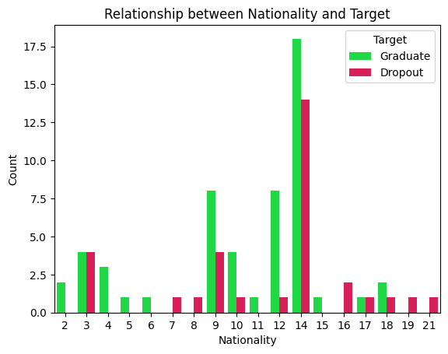
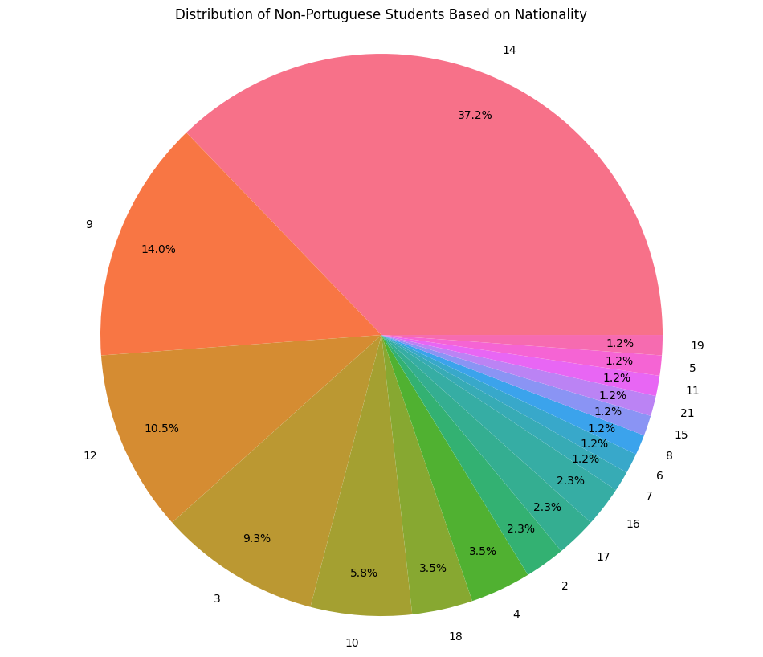
Visualizations
When excluding Portuguese students the remaining 2.4% is made up of students from mostly other Lusophone countries (nr 14 is Brazil and nr 9 is Cape Verde).
The influence of nationality on student status is unclear, especially considering the data is so small for nationalities that are not Portuguese.
Since there are more than 30 columns we can’t visualize the influence of all of them in this presentation so let’s move on to other ML algorithms.

Slide 14
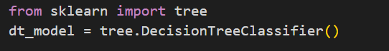
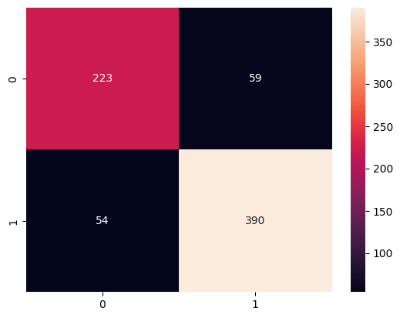
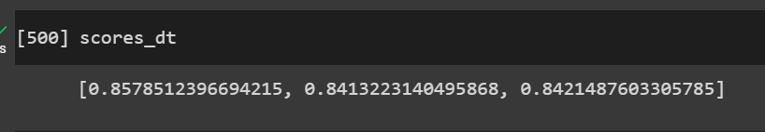
Decision Tree
Using Decision tree algorithm, from the confusion matrix, we can see how the model performed.
Using K Fold Cross Validation we can see that the score of our model performance is somewhere around those values which we tell it’s a lot less than what we got from regression:

Slide 15
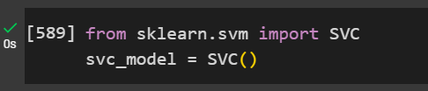
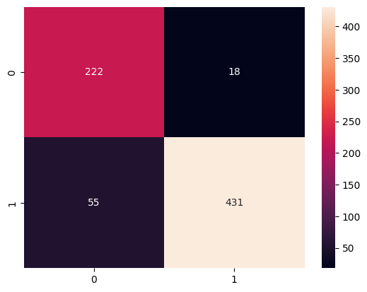
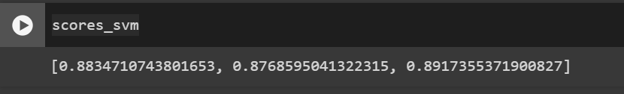
Support Vector Machine
Using SVM, from the confusion matrix, we can see how the model performed.
Using K Fold Cross Validation we can see that the score of our model performance is somewhere around those values:

Slide 16
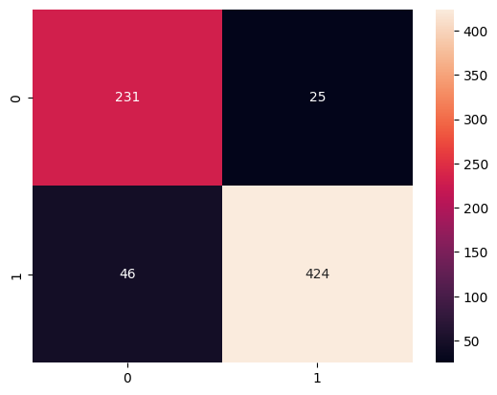
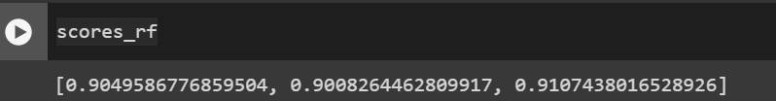
Random Forest
Using random forest algorithm, from the confusion matrix, we can see how our model performed with n_estimators=50.
Using K Fold Cross Validation we can see that the score of our model performance is somewhere around those values:

Slide 17
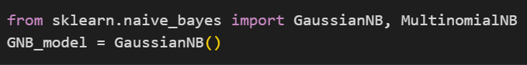
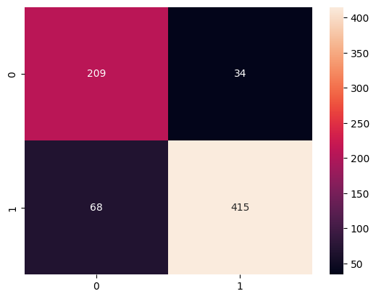
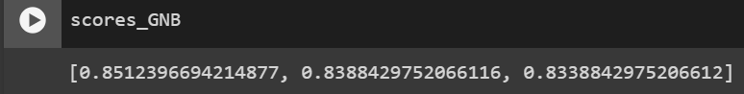
Gaussian Naive Bayes
From the confusion matrix, we can see how our model performed.
Using K Fold Cross Validation we can see that the score of our model performance is somewhere around those values:

Slide 18
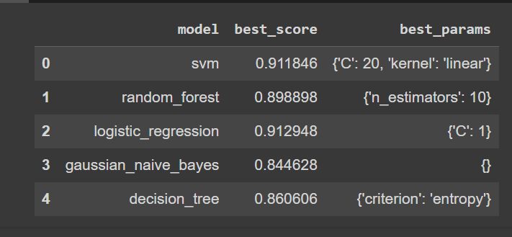
Hyper parameter Tuning (GridSearchCV)

Slide 19
Conclusion
In conclusion, for the best predictions in our data data, Logistic regression, Support Vector Machine, and the random forest algorithms worked the best.

Slide 20
THANKYOU

